Slide 1

BANKING ANALYTICS PROJECT
Presented By:-
Apoorva
Vaibhav
Devata
Harshita
Abhishek

Slide 2

What is Banking Analytics
It is a process of using data to make informed decisions in the banking industry.It involves collecting of data from variety of sources.
Data is analysed,trends identified and prediction made.This helps managers to make better business decisions.

Slide 3
Objectives The main goal was to take a handful of important performance metrics (KPIs) and turn them into easy-to-understand visualizations. The aim was to create clear charts and graphs that not only tackled the specific KPIs given but also made it simple for everyone to grasp how the company was doing. This objective pushed me to enhance my data analysis skills and communicate insights visually, helping to make better-informed decisions based on the data.

Slide 4
Role of Analytics in Banking and Finance sector
Risk
Supply
Demand
Moniter and mitigate financial risk.
Effective risk management.
Evaluate credit risk of granting a loan to customers.
Prevention of operation and liquidity risk
Measuring sales performance and cash flow.
Analysis of sales channels.
Use of virtual assistant for time management.
Personalized customer information for marketing.
Prediction of customer lifetime value with bank.
Evaluate consumer behavior pattern and expand banking services.

Slide 5
Summary or Overview
Working on finance datasets i.e.finance1 and finance 2.
Performing cleaning on datasets and remove empty
column,duplicates,null values etc.
Performing insights of data on datasets through working over four different modules.
These are :-
Excel Dashboard
Power BI Dashboard
Tableau Dashboard
SQL

Slide 6
KPI’S(Key Performance Indicators)
Year wise loan amount Status.
Grade and sub grade wise revol_bal.
Total Payment for Verified Status Vs Total Payment for Non Verified Status.
State wise and month wise loan status.
Home ownership Vs last payment date status.

Slide 7
The project is based on the following Key Performance Indicators (KPIs), which are aligned with different modules including Excel, Power BI, Tableau, and SQL. The entire project focuses on Bank Analytics, utilizing data from Finance_1.xlsx and Finance_2.xlsx datasets in Excel format, each containing over 39,000 records. It aims to assist financial institutions in making data-driven decisions through the collection, analysis, and interpretation of data. Year wise loan amount Stats Grade and sub grade wise revol_bal Total Payment for Verified Status Vs Total Payment for Non Verified Status State wise and month wise loan status Home ownership Vs last payment date stats

Slide 8
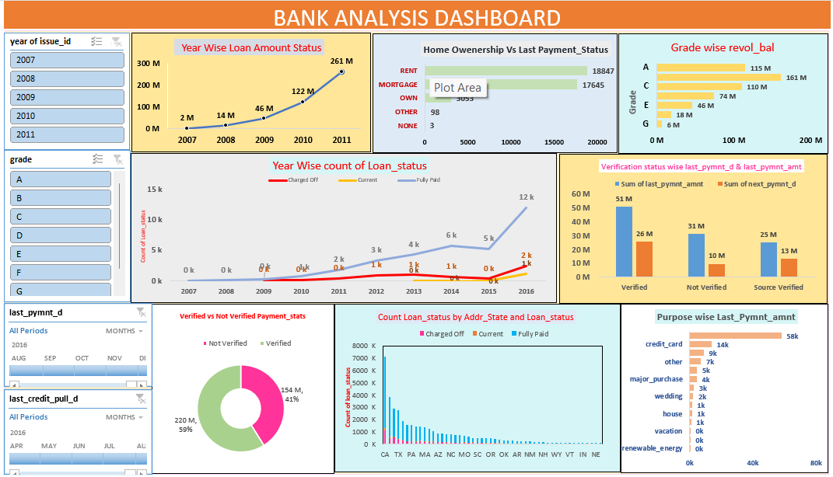
Excel Dashboard
The Excel dashboard is equipped with a diverse range of graphs that effectively illustrate key performance indicators (KPIs) derived from data. These graphs encompass line charts, pie charts, bar charts, and column charts, each tailored to represent specific KPIs.

Slide 9
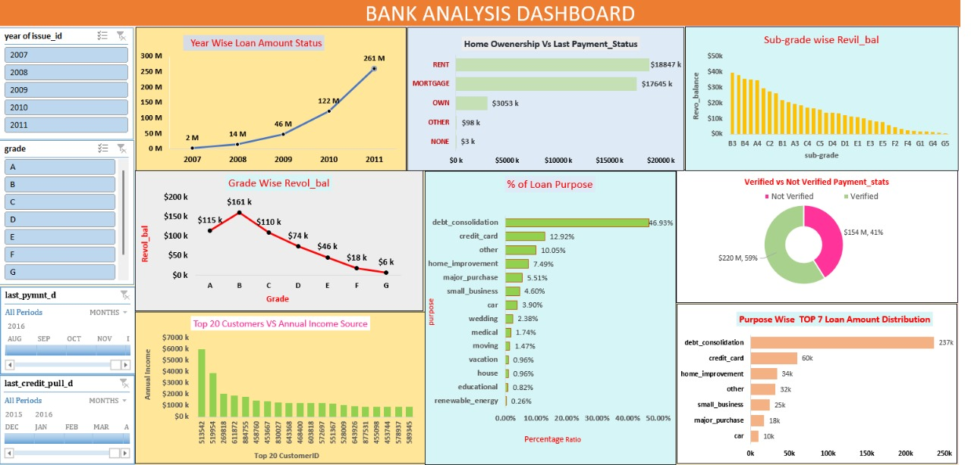
Excel Dashboard

Slide 10
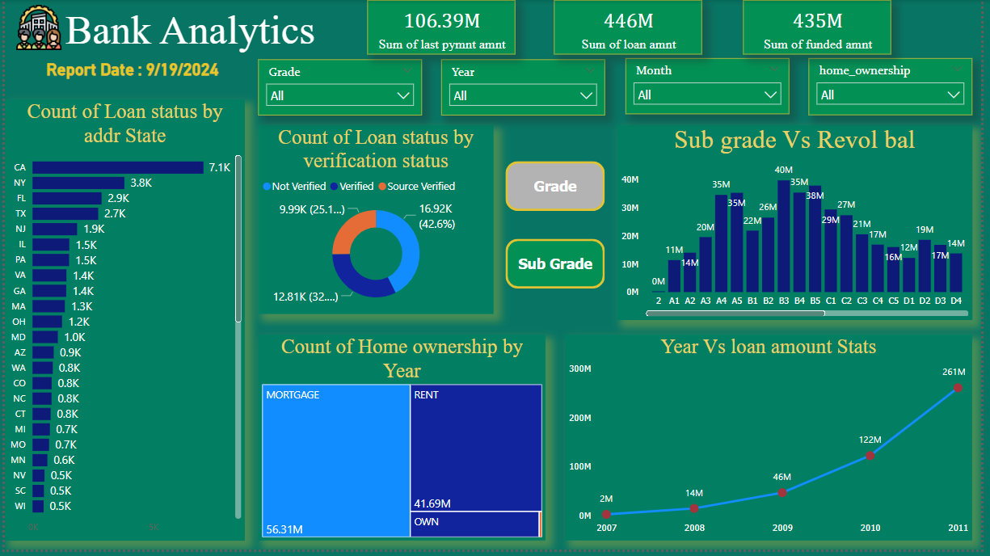
Power BI Dashboard
Power BI is a powerful business analytics service provided by Microsoft, offering interactive visualizations and business intelligence capabilities through a user-friendly interface. The choice between Excel and Power BI for creating dashboards depends on specific organizational needs, considering factors such as data size, required interactivity, and budget. Excel may be sufficient for smaller, static datasets, while Power BI is better suited for handling large datasets, providing deeper insights with advanced analytics, and enabling collaborative decision-making. Our presentation will showcase a project using Power BI, featuring various dashboard elements.

Slide 11
Power BI Dashboard

Slide 12
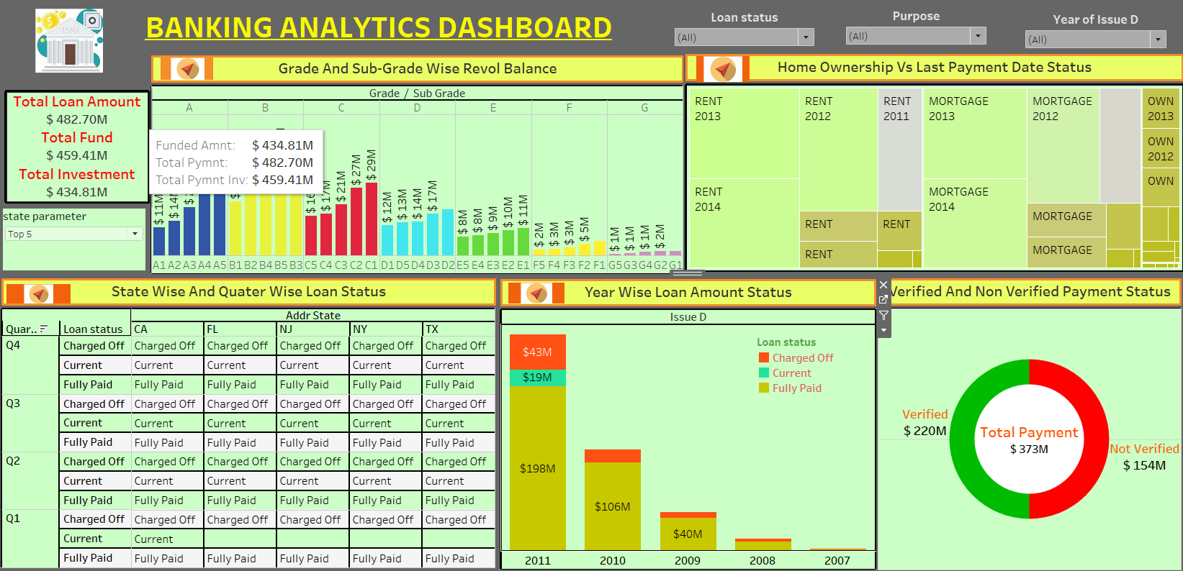
Tableau Dashboard

Slide 13
Tableau Dashboard
Tableau is a widely-used data visualization tool in the business intelligence industry, simplifying raw data into easily understandable formats. It enables fast data analysis, creating visualizations in the form of dashboards and worksheets. The software allows data blending and real-time collaboration, making it unique. It is used by businesses, researchers, and government organizations for visual data analysis. When choosing between Tableau and Power BI, the decision often depends on specific business needs, budget, existing infrastructure, and the level of complexity required in data analysis and reporting. Tableau is preferable for data-heavy, complex scenarios, while Power BI may be the better choice for cost-effectiveness and integration with Microsoft products. Here is the same data presented on a tableau tool using various methods to display all key performance indicators (KPIs).

Slide 14
SQL Dashboard
To build a dashboard, one would require a free, open-source business intelligence tool like Metabase. The initial step involves integrating the database or RDBMS with the BI tool, enabling the execution of queries and the creation of a real-time SQL dashboard. These tools facilitate the transformation of raw SQL data into strategic insights accessible throughout the organization, thereby improving decision-making processes and operational efficiency.
An SQL dashboard serves as a visualization tool that presents crucial data insights obtained from SQL databases. It leverages SQL queries to directly extract data from databases and then presents this data in a visual, easily comprehensible format. These dashboards are integral to data-driven decision-making, allowing users to swiftly comprehend complex datasets and effectively monitor business metrics. The following are key aspects of SQL dashboards, encompassing their components, advantages, development process, and example tools utilized in their construction.

Slide 15
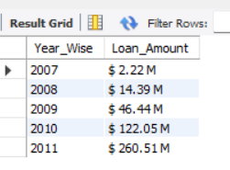
SQL Query for KPI’S
Kpi 1 :Year wise loan amount Status :-
Query :-
select year(issue_d) as Year_Wise,concat("$ ",round(sum(loan_amnt)/1000000,2)," M") as
Loan_Amount from finance_11 group by Year_Wise order by Year_Wise ;
Output :-

Slide 16
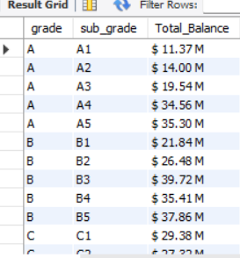
Kpi 2 : Grade and sub grade wise revol_bal.
Query :-
select grade,sub_grade,concat("$ ",round(sum(revol_bal)/1000000,2)," M") as
Total_Balance from finance_11 f1,finance_22 f2 where f1.id=f2.id group by
grade,sub_grade order by grade,sub_grade;
Output :-

Slide 17
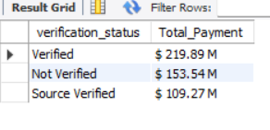
Kpi 3 : Total Payment for Verified Status Vs Total Payment for Non Verified
Status.
Query :-
select verification_status,concat("$ ",round(sum(total_pymnt)/1000000,2)," M") as
Total_Payment from finance_11 f1,finance_22 f2 where f1.id=f2.id group by verification_status;
Output :-

Slide 18
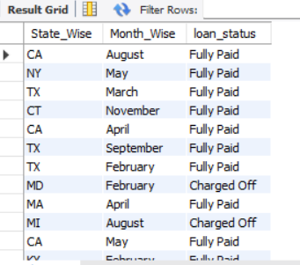
Kpi 4 : State wise and month wise loan status.
Query :-
select addr_state as State_Wise,monthname(issue_d) as Month_Wise,loan_status
from finance_11;
Output :-

Slide 19
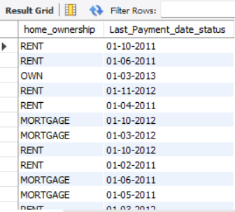
Kpi 5 :Home ownership Vs last payment date status.
Query :-
select home_ownership,last_pymnt_d as Last_Payment_date_status from
finance_11 f1,finance_22 f2 where f1.id=f2.id;
Output :-

Slide 20
THANK YOU !!!

